Slide 1
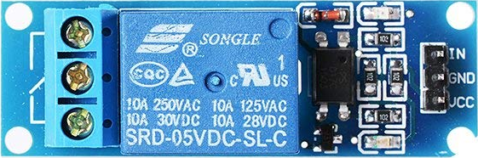
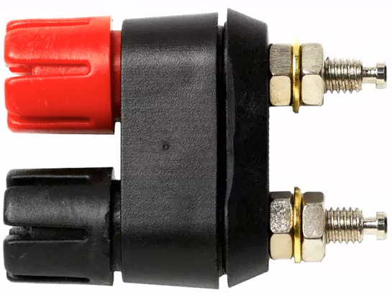
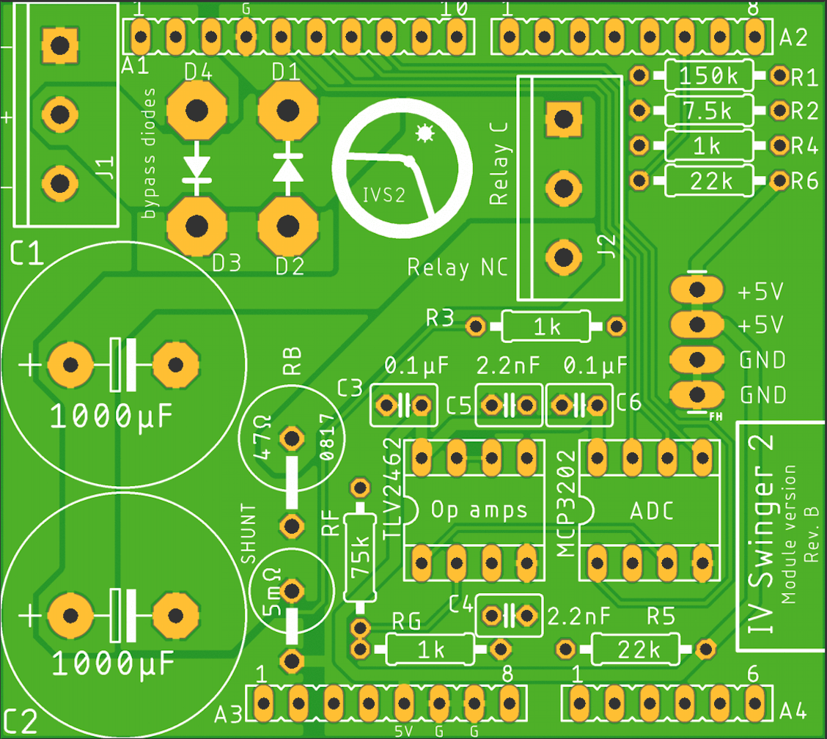
IV Swinger 2 Off-PCB Connections (Module, EMR)
4-inch Male
To Female
jumpers
RELAY NC
RELAY C
VCC
GND
RELAY IN
PV+
PV-
18ga zip cord
(or solid core)
load circuit wires

Slide 2
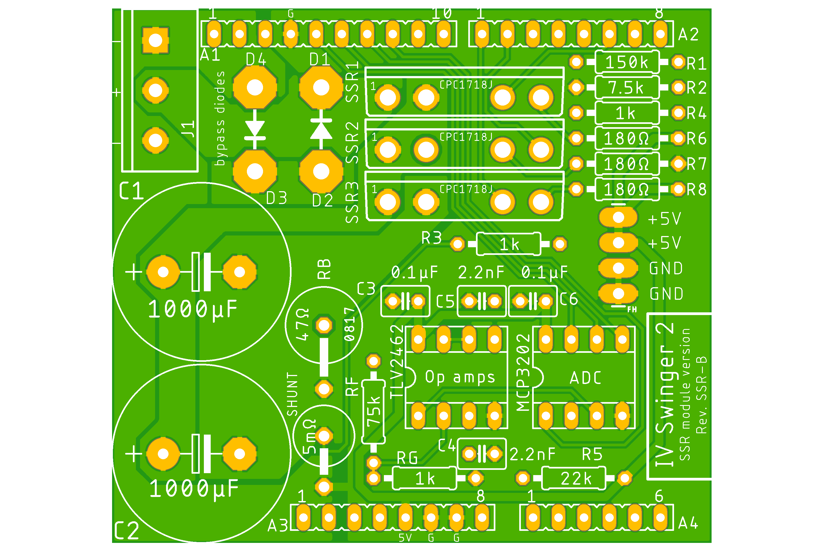
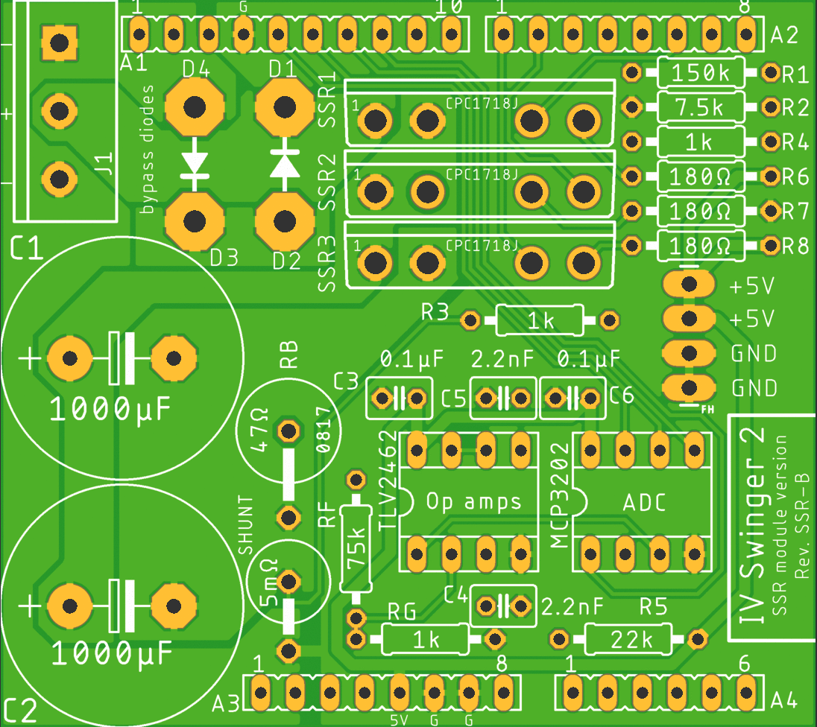
IV Swinger 2 Off-PCB Connections (Module, SSR)
PV+
PV-
18ga zip cord
(or solid core)
load circuit wires

Slide 3
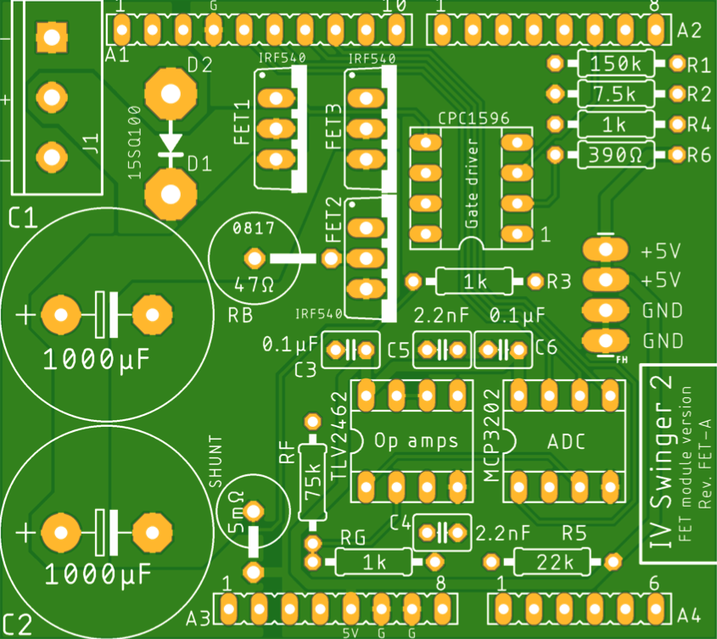
IV Swinger 2 Off-PCB Connections (Module, FET)
PV+
PV-
18ga zip cord
(or solid core)
load circuit wires

Slide 4
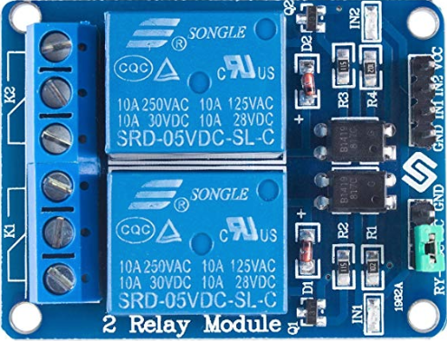
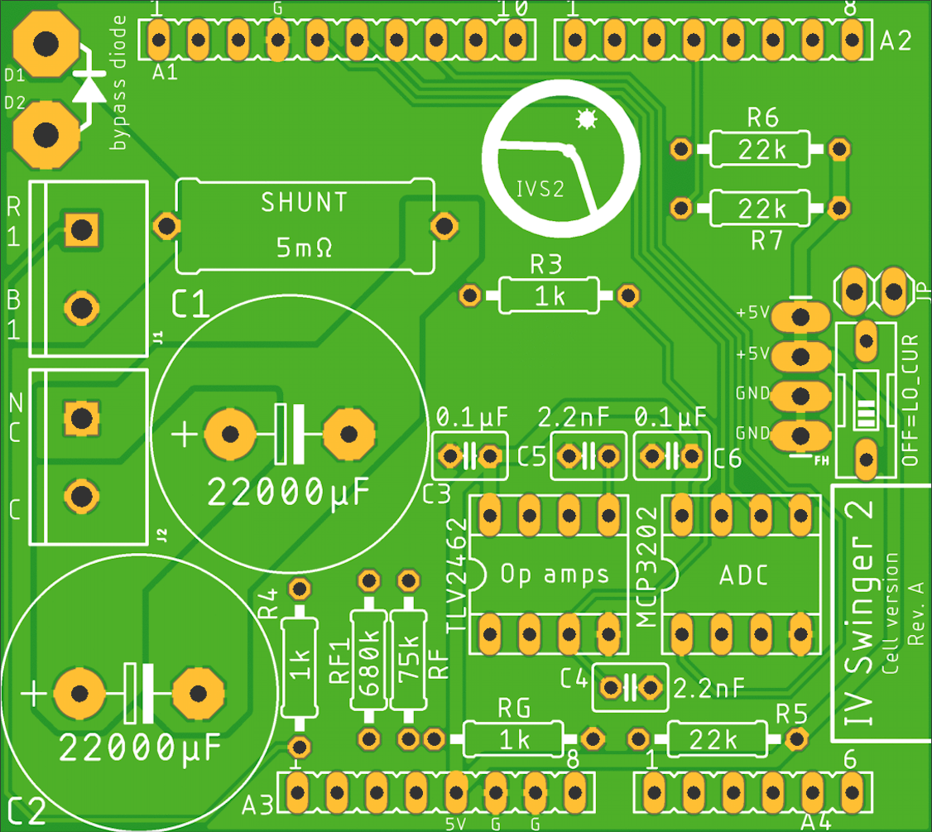
IV Swinger 2 Off-PCB Connections (Cell, EMR)
RELAY IN2
RED2
4-inch Male
To Female
jumpers
BLK2
RED1_B
GND
RELAY IN1
VCC
RED1_A
BLK1
18ga zip cord
(or solid core)
load circuit wires
RELAY NC
RELAY C

Slide 5
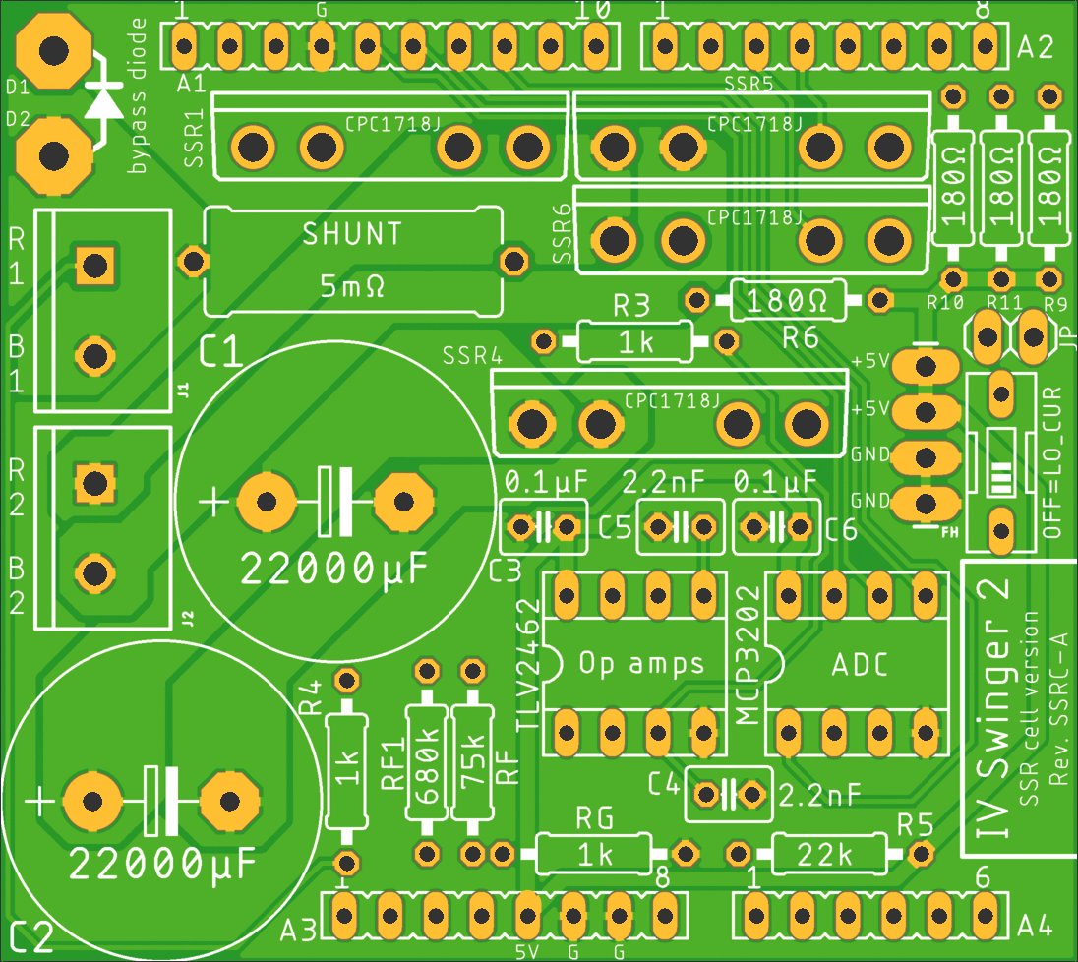
IV Swinger 2 Off-PCB Connections (Cell, SSR)
RED2
BLK2
RED1
BLK1
18ga zip cord
(or solid core)
load circuit wires

